Slide 1


INTERNSHIP SUBJECT CODE:21INT68 Mobile Price Range Prediction using KNN Algorithm
SAPTHAGIRI COLLEGE OF ENGINEERING
Affiliated to VTU, Belagavi, Approved by AICTE, NEW DELHI (ISO 9001-2015 & ISO14001-2015 certified Institute)
14/5, Chikkasandra, Hesarghatta Main Road, Bengaluru – 560057
Department of Computer Science and Engineering Accredited by NBA
GUIDE NAME: Prof. SHWETHA K
Assistant Professor
Department of CSE
NAME: SANDESH G C
USN: 1SG21CS084

Slide 2
ABSTRACT
This project explores the application of K-Nearest Neighbors (KNN) algorithm for predicting the price range of mobile phones based on various features.
The dataset comprises numerous attributes such as battery power, RAM, internal memory, screen size, and camera quality, which are critical determinants of a mobile phone's price.
The goal is to build a predictive model that accurately classifies mobile phones into predefined price ranges.
The dataset is preprocessed to handle missing values, normalize the features, and split into training and test sets.
Various distance metrics and values of 'k' are experimented with to optimize the model's performance.
The model's accuracy is evaluated using cross-validation techniques and performance metrics such as precision, recall, and F1-score.

Slide 3
INTERNSHIP DOMAIN
DATA SCIENCE: Data Science is a multidisciplinary field that uses scientific methods, processes, algorithms, and systems to extract knowledge and insights from structured and unstructured data. It combines aspects of mathematics, statistics, computer science, domain expertise, and other related fields to analyze and interpret complex data.
MACHINE LEARNING: Machine Learning, a subset of artificial intelligence (AI), is the scientific study of algorithms and statistical models that computer systems use to perform specific tasks without explicit instructions, relying on patterns and inference instead.
DATA SCIENCE AND MACHINE LEARNING: Data Science and Machine Learning are interdisciplinary fields that leverage data analysis, statistical methods, and algorithmic techniques to extract insights, make predictions, and inform decision-making processes.

Slide 4
PROJECT INTRODUCTION
Data Collection and Preprocessing: Gather a dataset containing various features of mobile phones along with their corresponding price ranges. The dataset will be preprocessed to handle missing values, normalize the features, and split into training and test sets.
Model Development: Implement the KNN algorithm and experiment with different distance metrics and values of 'k' to optimize the model's performance.
Model Evaluation: Evaluate the model's accuracy using cross-validation techniques and performance metrics such as precision, recall, and F1-score.
Analysis and Insights: Analyze the significance of different mobile phone features in determining their price range and provide insights based on the model's predictions.
This project demonstrates the potential of the KNN algorithm in predicting mobile phone price ranges and highlights the importance of feature selection in building accurate predictive models. The findings can be leveraged to enhance consumer experience and support strategic decision-making in the mobile phone industry.

Slide 5
METHODOLOGY
To predict mobile price ranges using k-NN, begin by collecting and preprocessing relevant data, ensuring to handle missing values and normalize the data.
Split the dataset into training and testing sets.
Train a k-NN model, selecting an appropriate k value through cross-validation.
Evaluate the model's performance using accuracy, confusion matrix, and classification metrics.
Fine-tune the model by experimenting with different k values and distance metrics. Finally, deploy the model for real-time price range predictions, ensuring consistent preprocessing of new data.

Slide 6
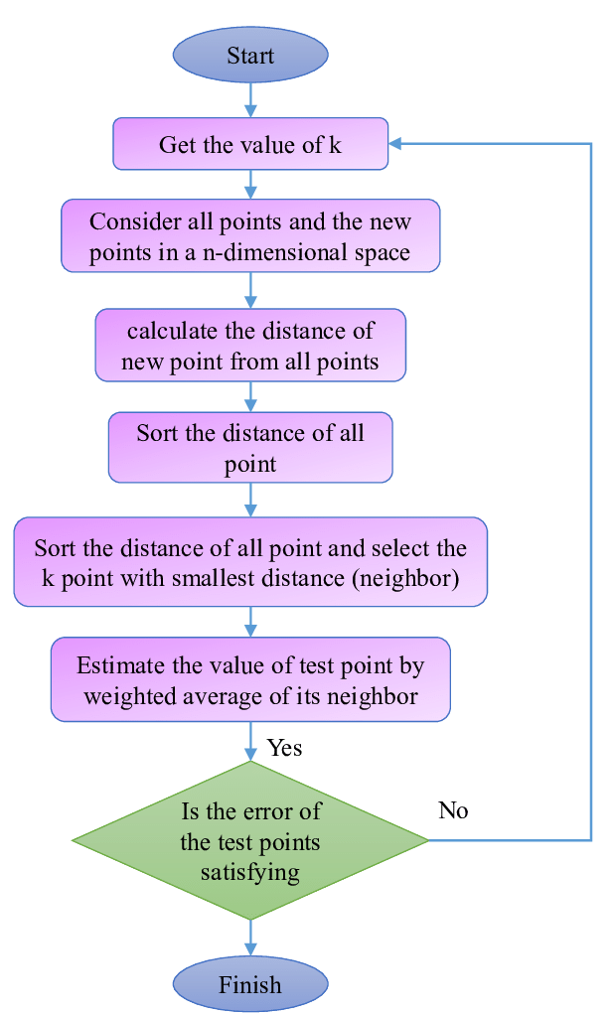
FLOW DIAGRAM

Slide 7
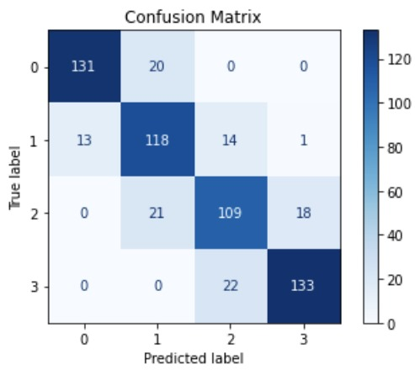
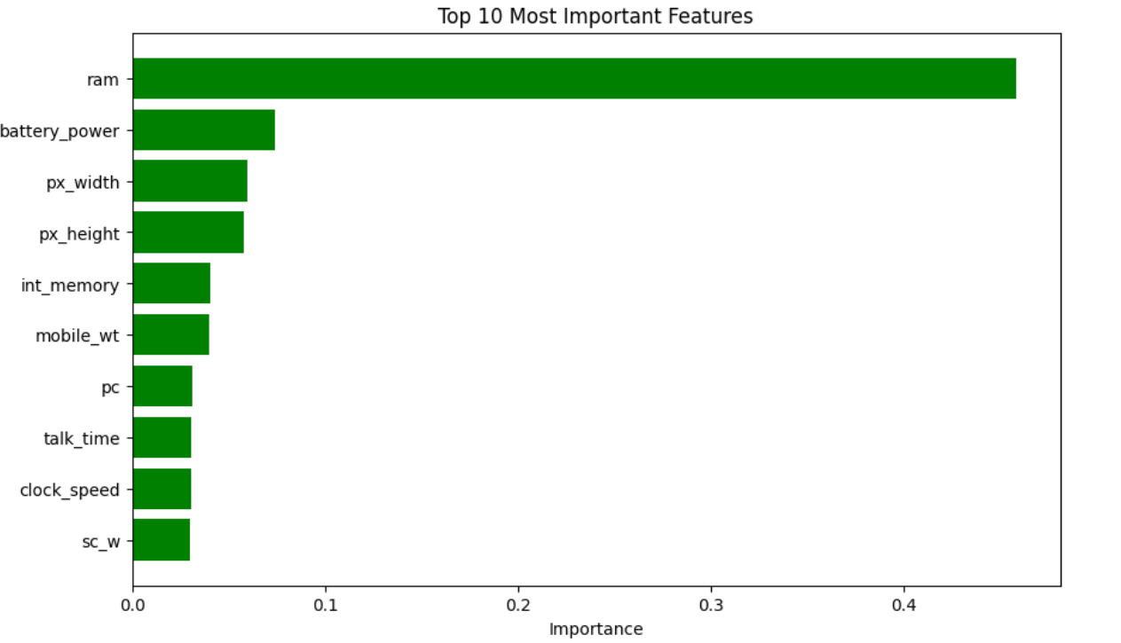

Slide 8
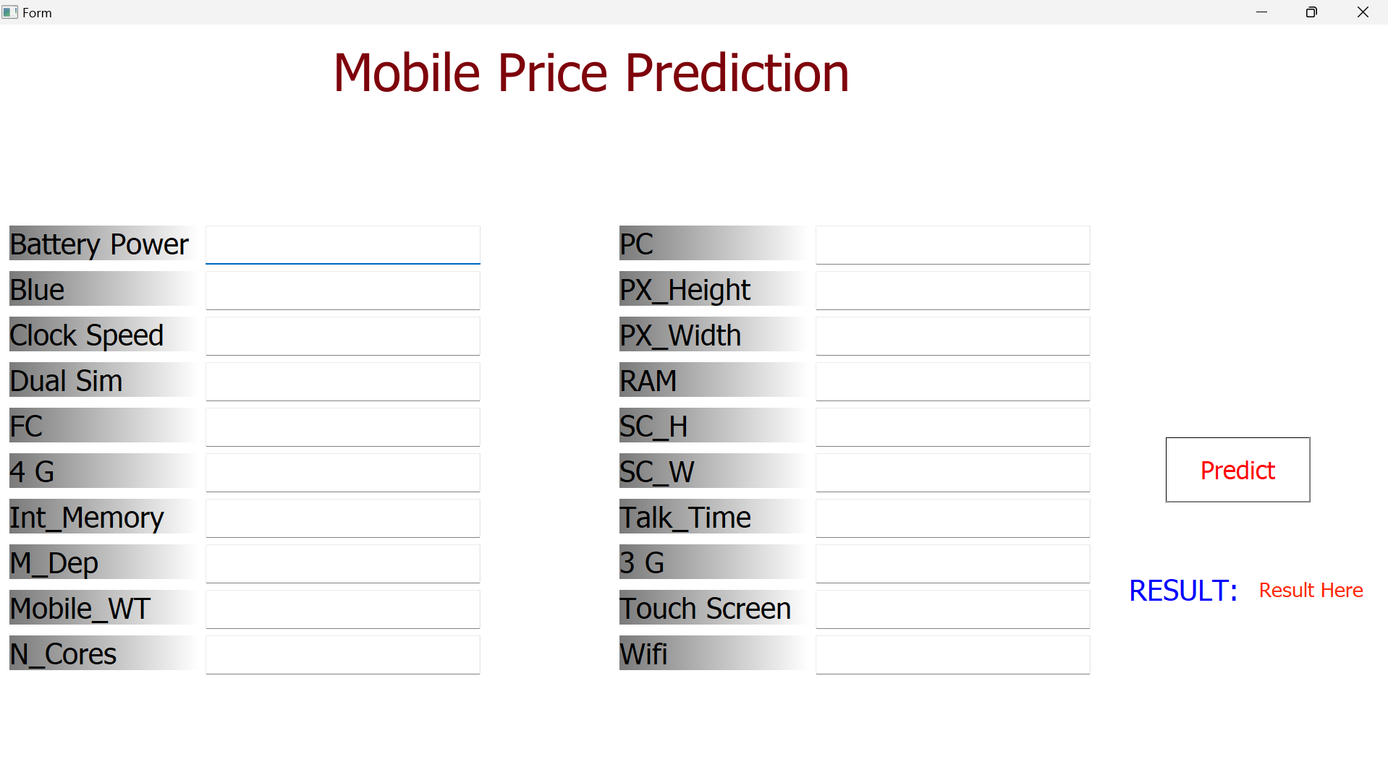
RESULT

Slide 9
CONCLUSION
The internship aims to use Python programming language for Machine Learning so as to apply the theoretical knowledge to solve real-time and complex problems.
The internship helped to find appropriate prediction model to the problems by applying suitable learning algorithm which can be used in future.
The internship project assigned by the company helped to improve programming skills and to implement basic knowledge for solving real world problem.
In this project KNN Algorithm is used to predict mobile price range prediction. After having a basic understanding of Supervised learning, we explored the KNN Algorithm which is used to solve machine learning problem.
The result varies based on the inputs given in the dataset and gives the result as yes or no.

Slide 10
FUTURE ENHANCEMENT
Integration of Additional Features: Incorporate more features such as user reviews, brand reputation, and market trends to improve the model's accuracy and comprehensiveness in predicting mobile phone price ranges.
Advanced Algorithms: Explore and compare advanced machine learning algorithms like Random Forest, Gradient Boosting, and Neural Networks to potentially enhance predictive performance and robustness.
Dynamic Model Updating: Implement a dynamic updating mechanism where the model is periodically retrained with new data to keep up with the latest market trends and newly released mobile phone models.
Geographical Customization: Tailor the model to account for regional variations in pricing and consumer preferences, providing more localized and relevant predictions for different markets.
User Interface Development: Develop an intuitive user interface that allows non-technical users, such as consumers and business analysts, to easily input mobile phone features and obtain price range predictions.

Slide 11
REFERENCES
Taiwo Ayodele, “Types of Machine learning algorithms”, 2018
https://www.youtube.com/c/karunadutechnologiesprivatelimited https://www.karunadutechnologies.com
Alpaydin, E., “Introduction to Machine Learning”, 2004
Victor Roman, “Machine Learning Project: Predicting Boston House Prices With Regression”, 20 Jan 2019

Slide 12
THANK YOU

